Slide 1

Welcome to the CSITEd Experts Online Forum
Contact:
Email: CSITEdExperts@gmail.com
Blog: csitedexperts.wordpress.com
Facebook: facebook.com/CSITEdExperts
YouTube: youtube.com/CSITEdExperts
Please Like, Subscribe, Comment, and Contribute
to the CSITEd Experts Channel on YouTube

Slide 2

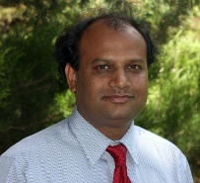
How to Write Good Pseudocodes?
num_1 ← READ number from user input
num_2 ← READ number from user input
num_3 ← READ number from user input
// Find the Average Number.
total ← 0, average ← 0
total ← num_1 + num_2 + num_3
average ← total / 3
PRINT ‘The average of the three numbers:’ + average
// Find the Average Number (Alternatively).
total ← 0, average ← 0
FOR i = 1 to 3
total ← total + num_i
ENDFOR
average ← total / 3
PRINT ‘The average of the three numbers:’ + average

Slide 3
How to Write Good Pseudocodes?
num_1 ← READ number from user input
num_2 ← READ number from user input
num_3 ← READ number from user input
// Find the Maximum Number.
temp_max ← -999999
FOR i = 1 to 3
IF num_i > temp_max
THEN temp_max ← num_i
ENDFOR
PRINT ‘Maximum Number:‘ + temp_max
Given Number Set: 3, -20, 40
After Iteration 1: temp_max = 3
After Iteration 2: temp_max = 3
After Iteration 3: temp_max = 40

Slide 4
How to Write Good Pseudocodes?
num_1 ← READ number from user input
num_2 ← READ number from user input
num_3 ← READ number from user input
// Find the Minimum Number.
temp_min ← 99999
FOR i = 1 to 3
IF num_i < temp_min
THEN temp_min = num_i
ENDFOR
PRINT ‘The Minimum Number:‘ + temp_min
Given Number Set: 3, -20, 40
Before Iteration 1: temp_min = 99999
After Iteration 1: temp_min = 3
After Iteration 2: temp_min = -20
After Iteration 3: temp_min = -20

Slide 5
Welcome to the CSITEd Experts Online Forum
Contact:
Email: CSITEdExperts@gmail.com
Blog: csitedexperts.wordpress.com
Facebook: facebook.com/CSITEdExperts
YouTube: youtube.com/CSITEdExperts
Please Like, Subscribe, Comment, and Contribute
to the CSITEd Experts Channel on YouTube

Slide 6
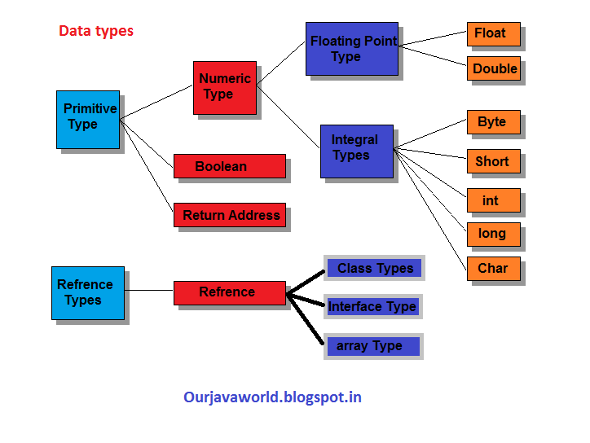
Variables and Data Types

Slide 7
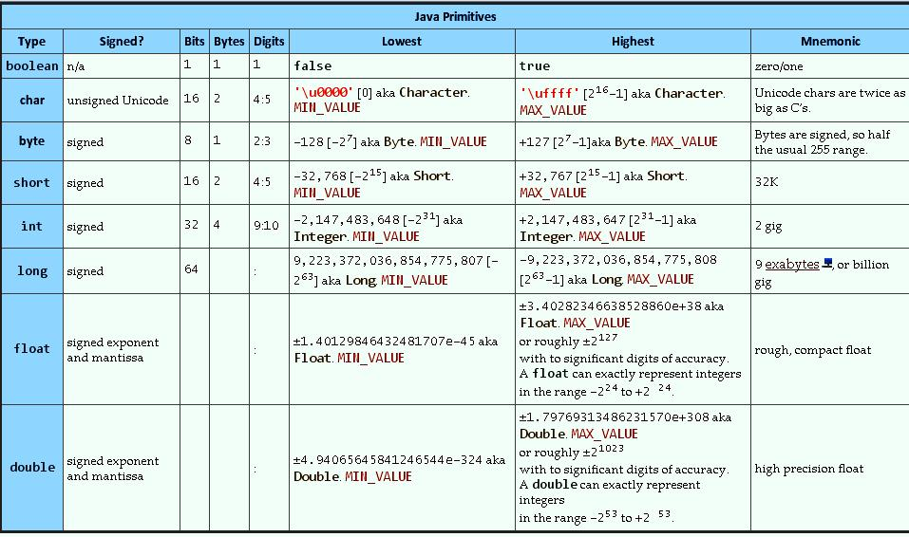
Variables and Data Types
Java Data Type Systems with Range

Slide 8
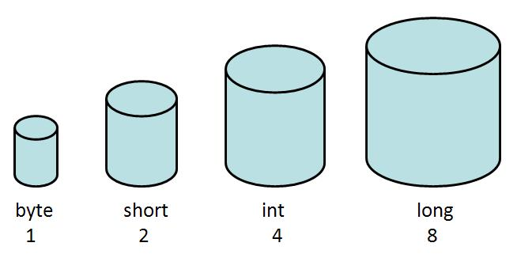

Variables and Data Types
boolean
Type Systems in Java

Slide 9
Variables and Data Types
Memory Address: 1231 1230 1229 1228 1227 1226 1225 1224 ... ...
x
Bit-7
Data Bit
(Either 0 or 1)
Bit-0
Figure: Data Saving technique for boolean type variables
Value Range: true or false; 1 = true, 0 = false

Slide 10
Variables and Data Types
Memory Address: 1231 1230 1229 1228 1227 1226 1225 1224 ... ...
0 1 0 0 0 0 0 1
Data Bits
Sign Bit (Bit-7)
Bit-6
Bit-0
Figure: Data Saving technique for byte type variables
Value Range: -2⁷ = -128 to 2⁷ -1 = 128-1 = 127; including 0.

Slide 11
Variables and Data Types
Memory Address: 1239 1224 ... ...
0 0 0 0 0 0 0 0 0 1 0 0 0 0 0 1
Data Bits (15 bits)
Sign Bit (Bit-15)
Bit-14
Bit-0
Figure: Data Saving technique for short type variables
Value Range: -2¹⁵ = -32768 to 2¹⁵ -1 = 32768-1 = 32767; including 0.

Slide 12
Variables and Data Types
Memory Address: 1255 1224 ... ...
0 0 0 0 0 0 0 0 1 0 0 0 0 0 1
Data Bits (31 bits)
Sign Bit (Bit-31)
Bit-30
Bit-0
Figure: Data Saving technique for int type variables
Value Range: -2³¹ = -2147483648 to 2³¹ -1 = 2147483648 -1 = 2147483647; including 0.
Memory Address: 1287 1224 ... ...
0 0 0 0 0 0 0 0 1 0 0 0 0 0 1
Data Bits (63 bits)
Sign Bit (Bit-63)
Bit-62
Bit-0
Figure: Data Saving technique for long type variables
Value Range: -2⁶³ = -9223372036854775808 to 2⁶³ -1 = 9223372036854775808-1 = 9223372036854775807; including 0.

Slide 13
Variables and Data Types
Memory Address:1256 1255 1248 1225 ...
Sign Bit (Bit-31)
Exponentials
8 bits
(Bit-23-Bit-30)
Bit-22
Mantissa 23 Bits
(Bit-0-Bit-22)
Bit-0
Bit-30
Figure: Data Saving technique for float type variables
Value Range: ±1.4x10⁻⁴⁵ to ±3.4028235x10⁺³⁸ ; including 0.
MemoryAddress:1288 1287 1225 ...
Bit-63
Exponentials
11 bits
(Bit-52-Bit-62)
Bit-51
Mantissa 52 Bits
(Bit-0-Bit-51)
Bit-0
Bit-62
Figure: Data Saving technique for double type variables
Value Range: ± 4.9x10⁻³²⁴ to ±1.7976931348623157x10³⁰⁸ ; including 0.

Slide 14
Variables and Data Types
Memory Address: ... 1239 1224 ...
0 0 0 0 0 0 0 0 0 1 0 0 0 0 0 1
Data Bits
Bit-15
Bit-0
Figure: Data Saving technique for char type variables
Value Range: 0 to 2¹⁶ -1 = 65536-1 = 65535; a total of 65536

Slide 15
Variables and Data Types
Memory Address: 1239 1224 ... ...
0 0 0 0 0 0 0 0 0 1 0 0 0 0 0 1
Data Bits (15 bits)
Sign Bit (Bit-15)
Bit-14
Bit-0
Figure: Data Saving technique for short type variables
Value Range: -2¹⁵ = -32768 to 2¹⁵ -1 = 32768-1 = 32767; including 0.
Difference between char and short Types
Memory Address: ... 1239 1224 ...
0 0 0 0 0 0 0 0 0 1 0 0 0 0 0 1
Data Bits
Bit-15
Bit-0
Figure: Data Saving technique for char type variables
Value Range: 0 to 65535 – total 65536

Slide 16
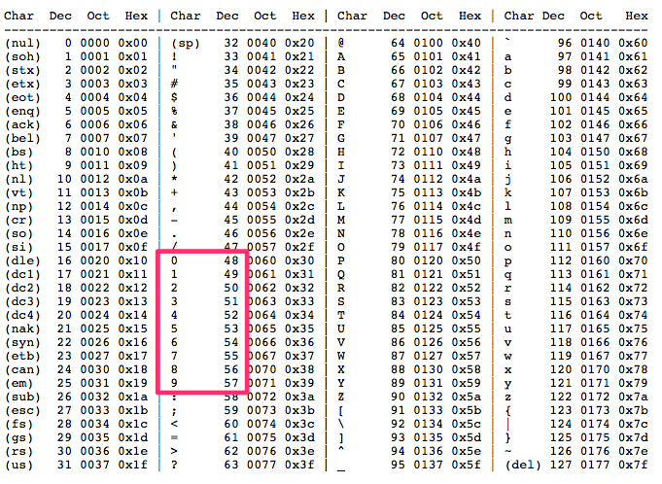
Variables and Data Types
8-bit ASCII Table

Slide 17
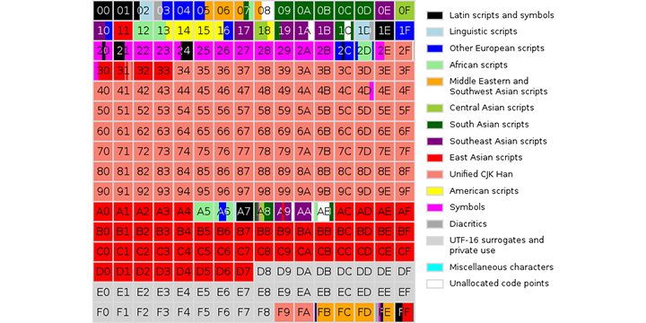
Variables and Data Types
Unicode System
Source: https://www.k-international.com/blog/what-is-unicode/
More at: https://en.wikipedia.org/wiki/Unicode

Slide 18
Variables and Data Types
Java Data Type Systems with Range

Slide 19

Variables and Data Types
Thank You!

Slide 20
Welcome to the CSITEd Experts Online Forum
Contact:
Email: CSITEdExperts@gmail.com
Blog: csitedexperts.wordpress.com
Facebook: facebook.com/CSITEdExperts
YouTube: youtube.com/CSITEdExperts
Please Like, Subscribe, Comment, and Contribute
to the CSITEd Experts Channel on YouTube

